Slide 1
美國印太戰略佈局＆台海安全前景
Dr. Yao-Yuan Yeh（葉耀元）
Professor and Fayez Sarofim – Cullen Trust for Higher Education Endowed Chair in International Studies
Department Chair of International Studies & Modern Languages
Department Chair of Political Science
University of St. Thomas, Houston

Slide 2
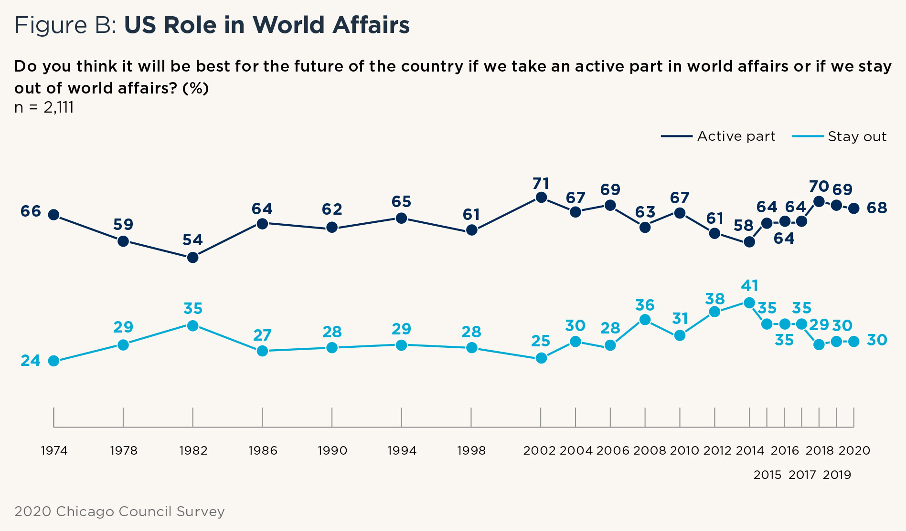
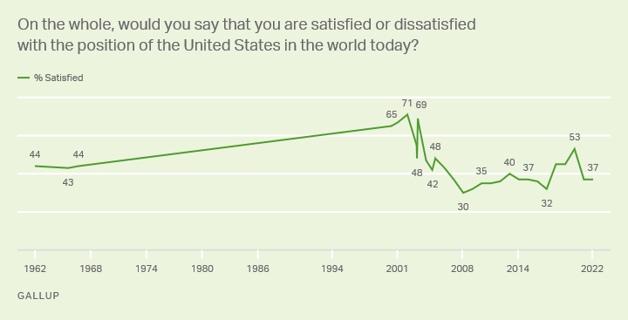
The US Global Strategic Placement after the Russo-Ukrainian War
The US strategic goals?
Integrated deterrence?
The merit of asymmetric warfare?
Strategic clarity vs. strategic ambiguity?

Slide 3
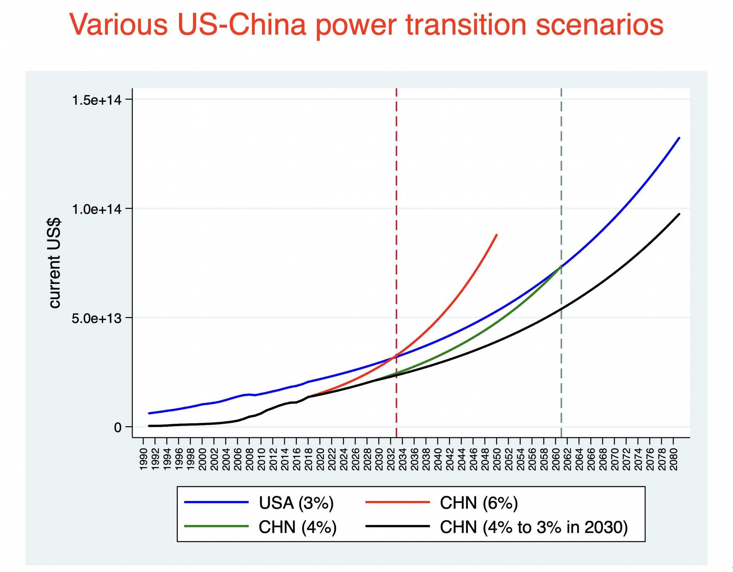
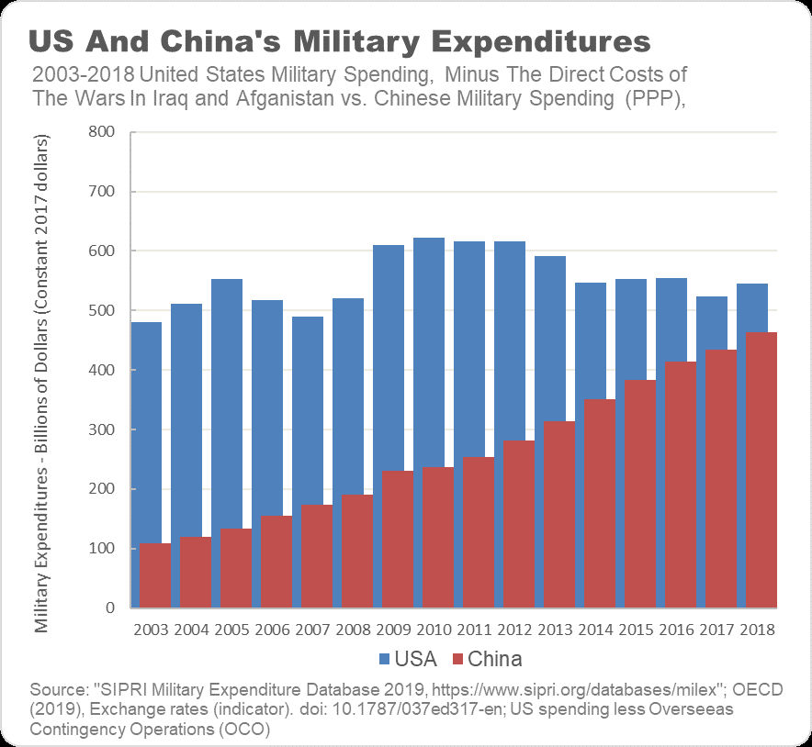
The US Strategic Goals
Maintaining the US hegemonic power
Containing the growth of China in both military and economy
China IS the #1 strategic competitor of the US

Slide 4
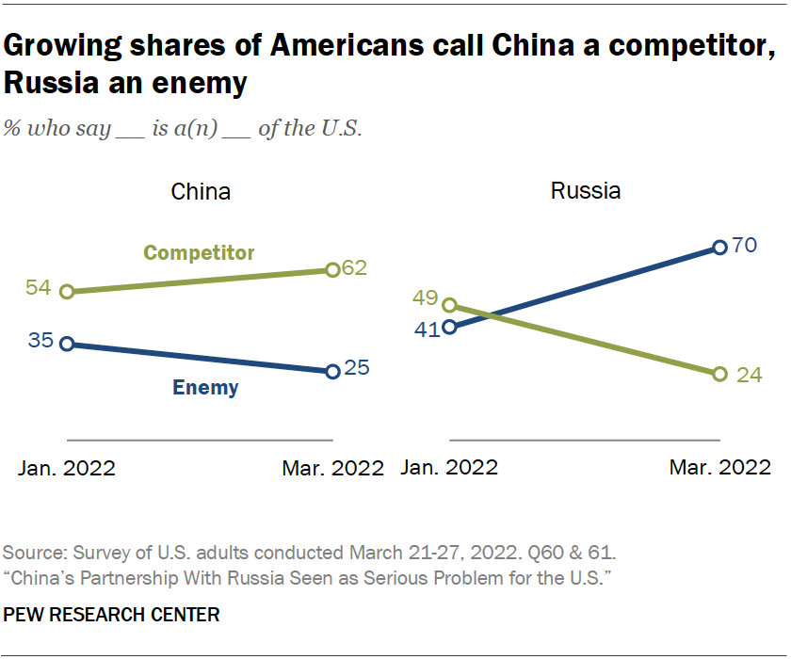
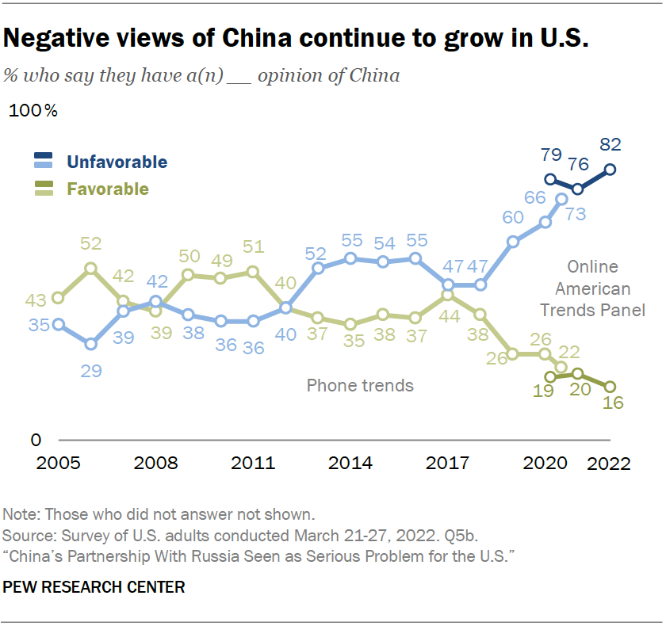
The US Strategic Goals
Public support against China reaches historical high

Slide 5
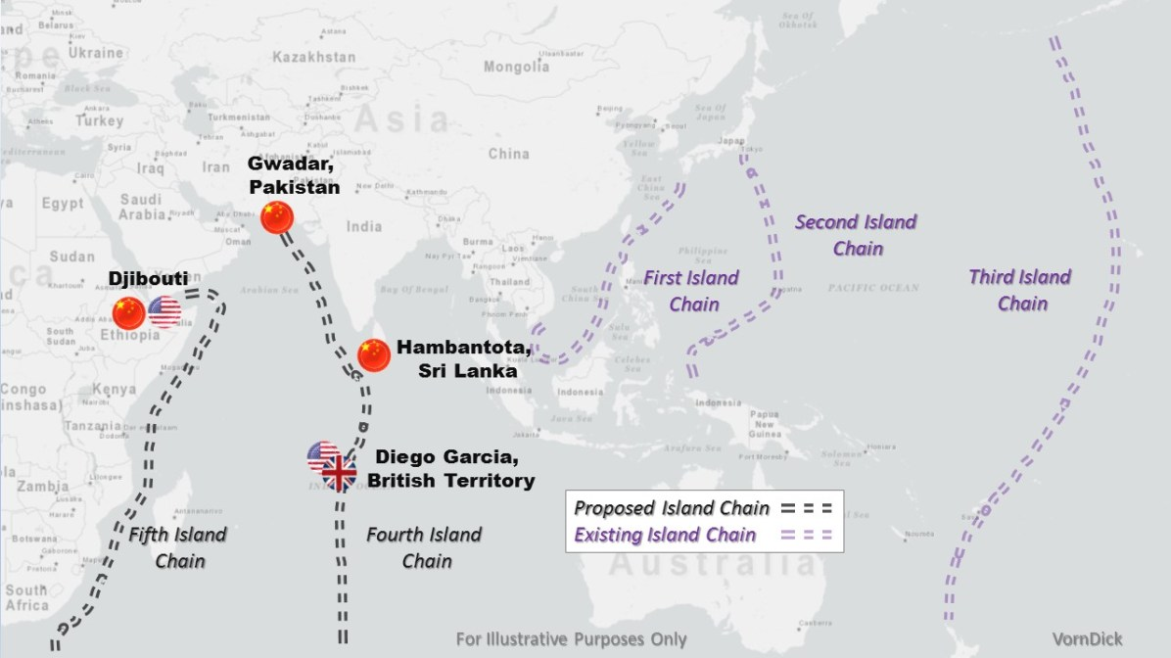
The US Strategic Goals
US as a naval hegemon

Slide 6
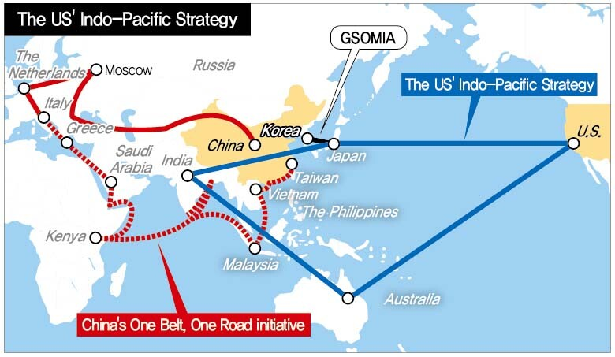
Integrated Deterrence
Indo-Pacific Strategic vs. China’s BRI
Indo-Pacific Economic Framework

Slide 7
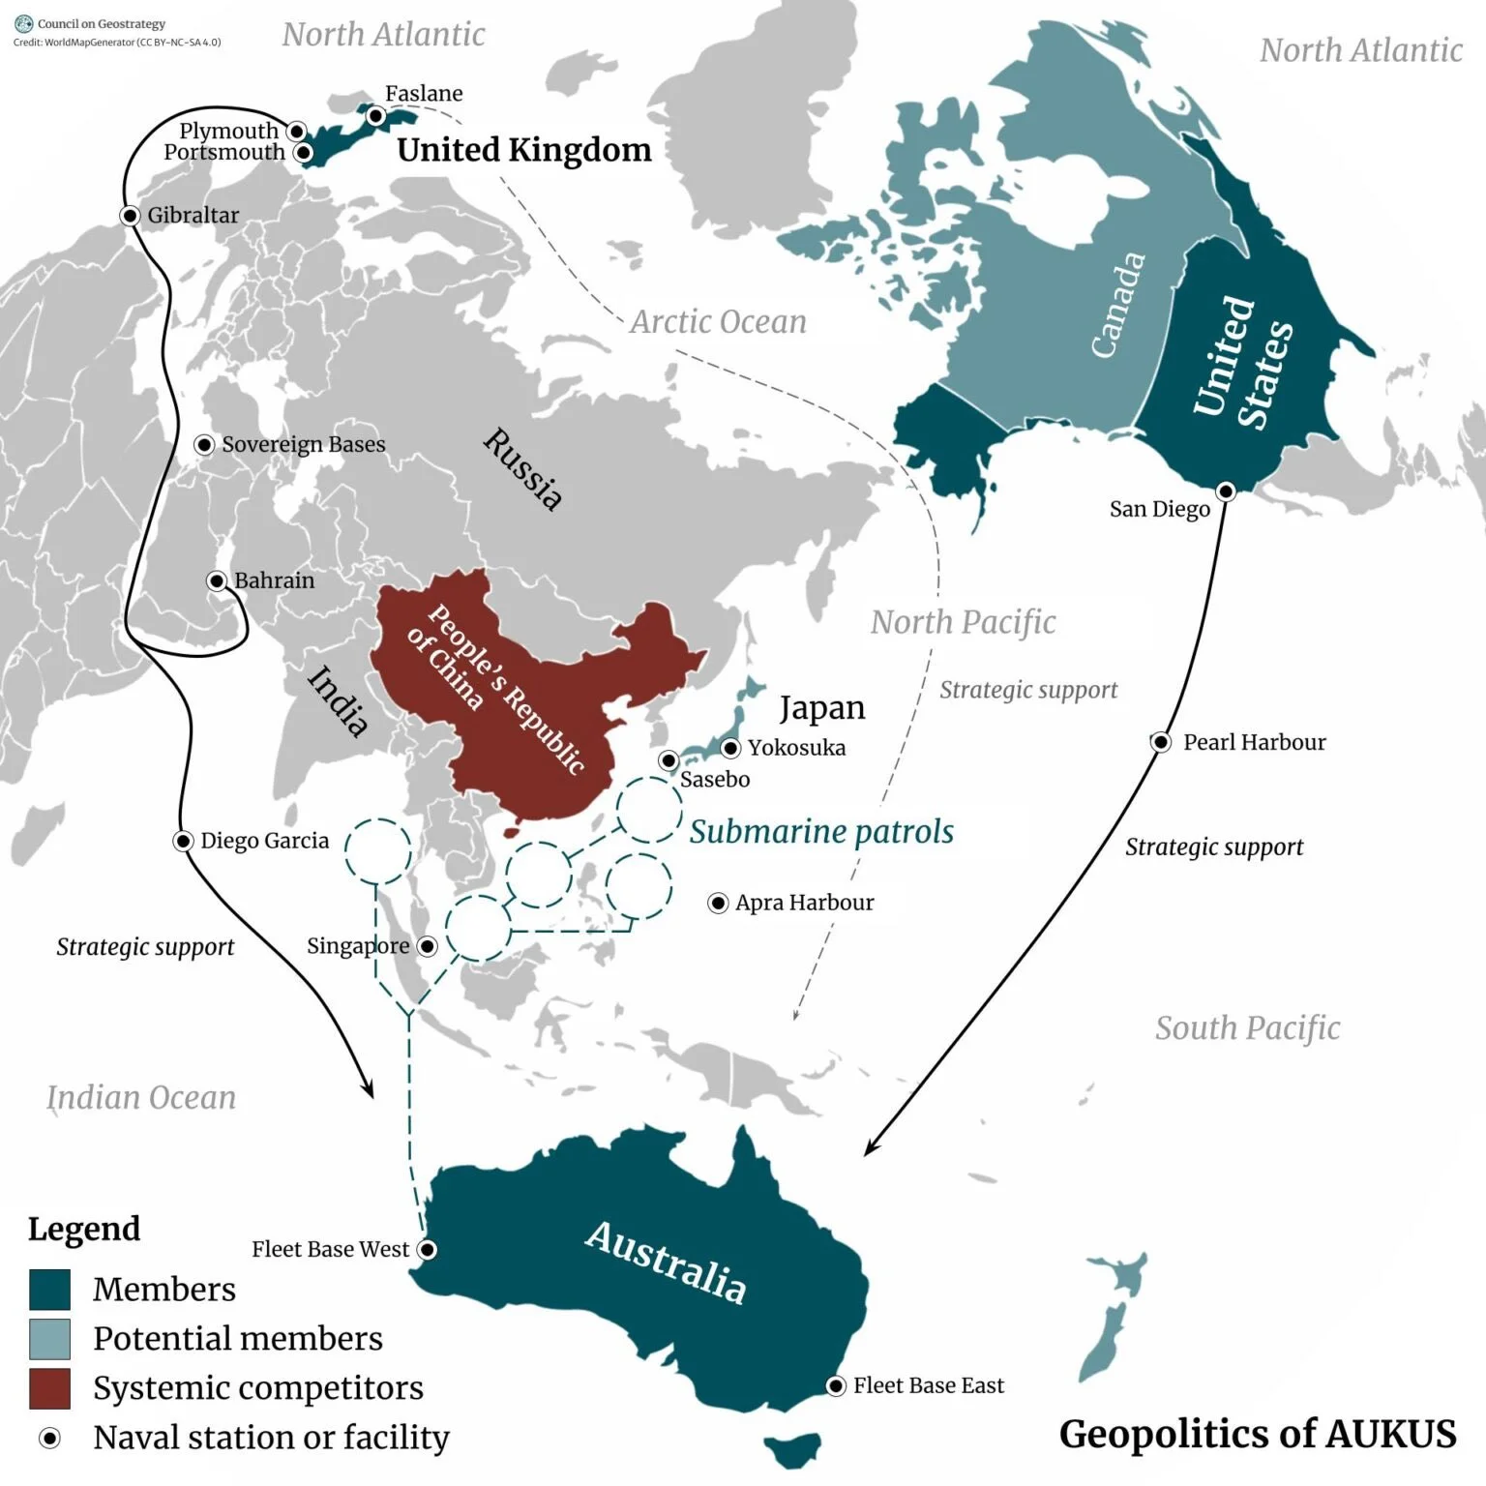
Integrated Deterrence
QUAD
AUKUS

Slide 8
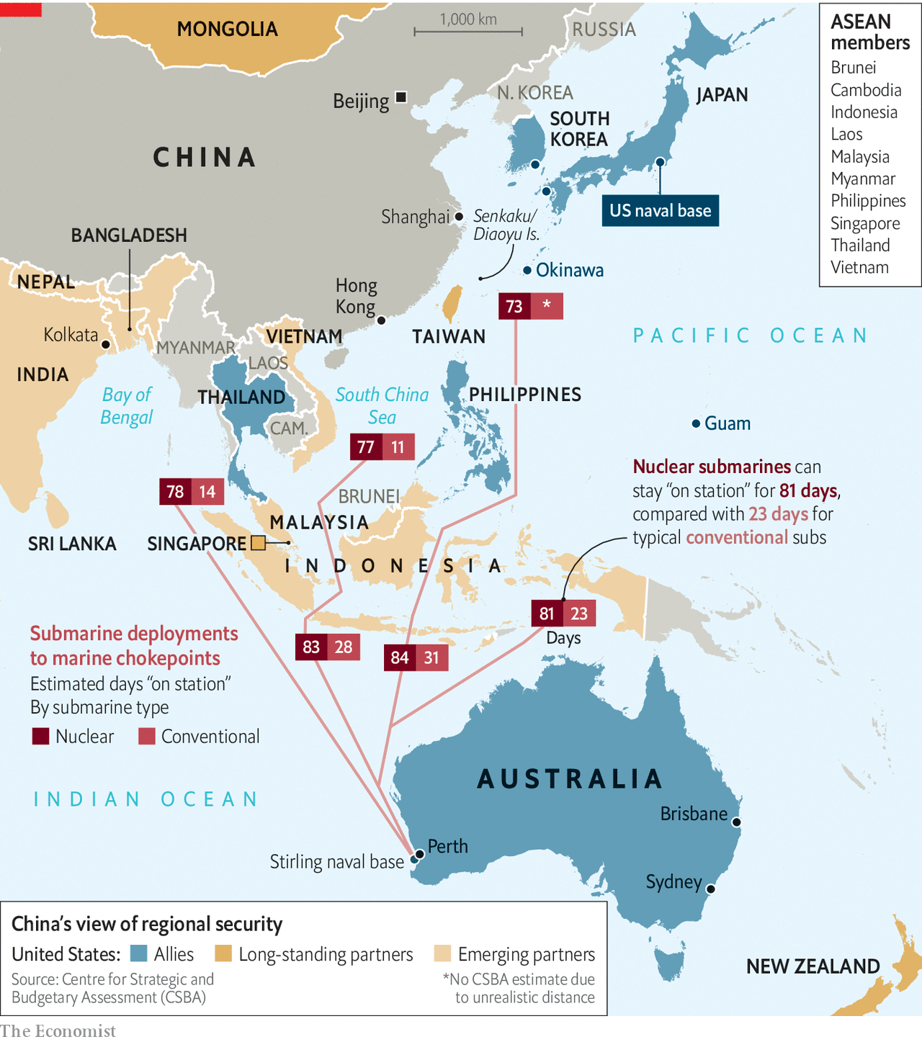
Integrated Deterrence
ASEAN?
CPTPP?
Park US nuclear submarines in South Korea

Slide 9
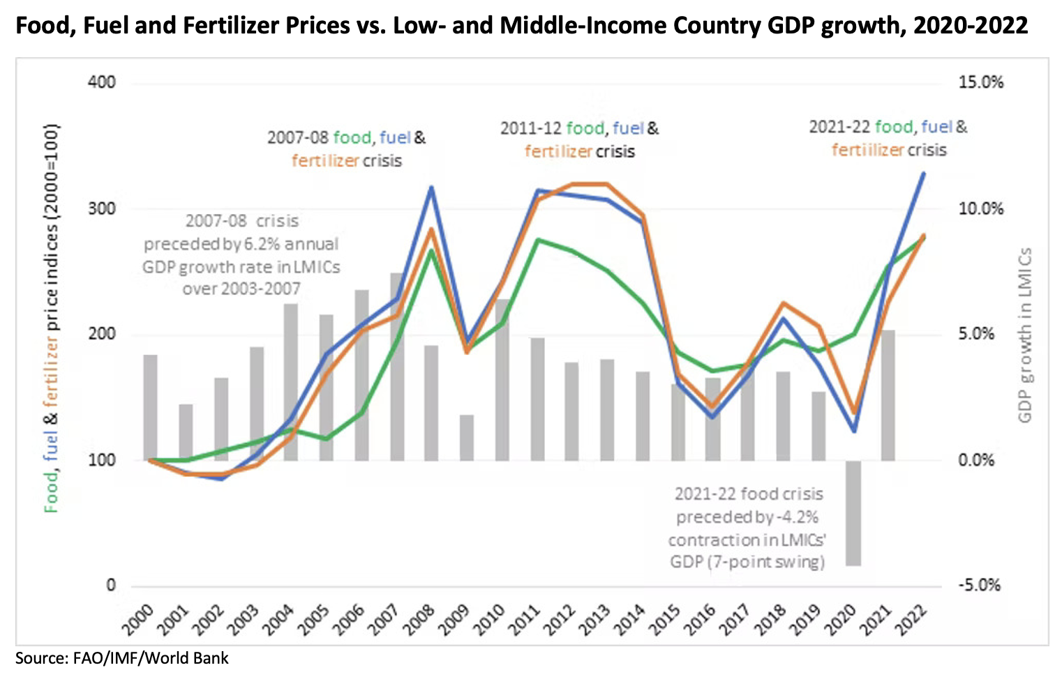
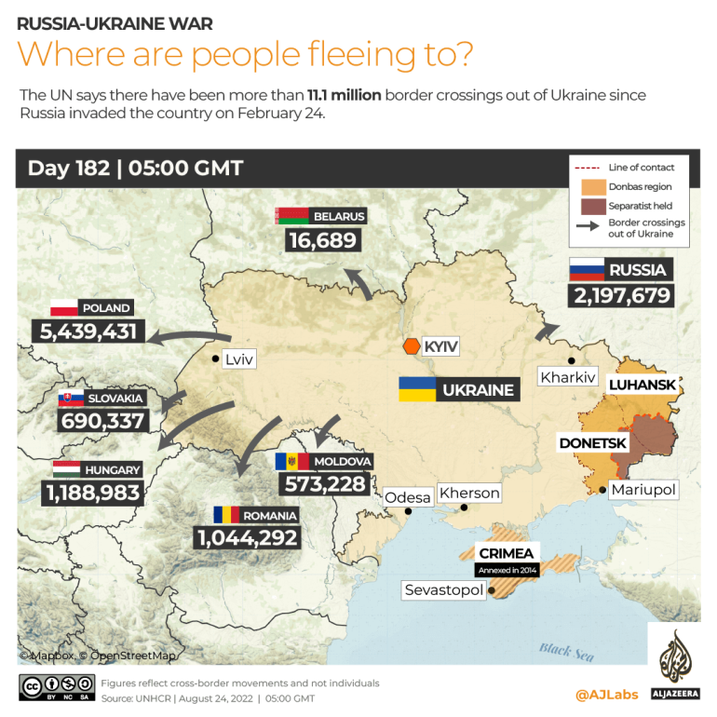
Integrated Deterrence: Regaining allies in Europe?
EU and NATO?
US commitment to NATO security
Over 11 million refugees
Food and energy shortage
Reshuffling of global supply chain and inflation

Slide 10
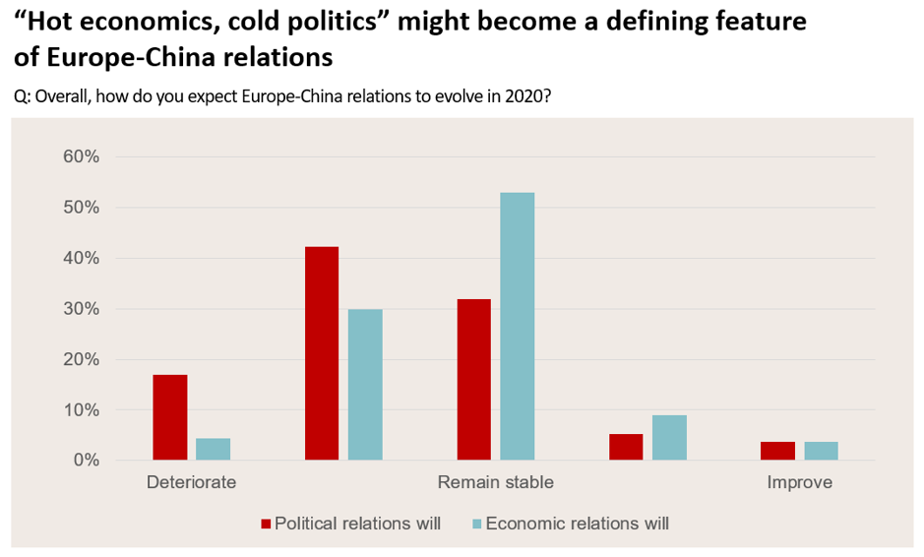
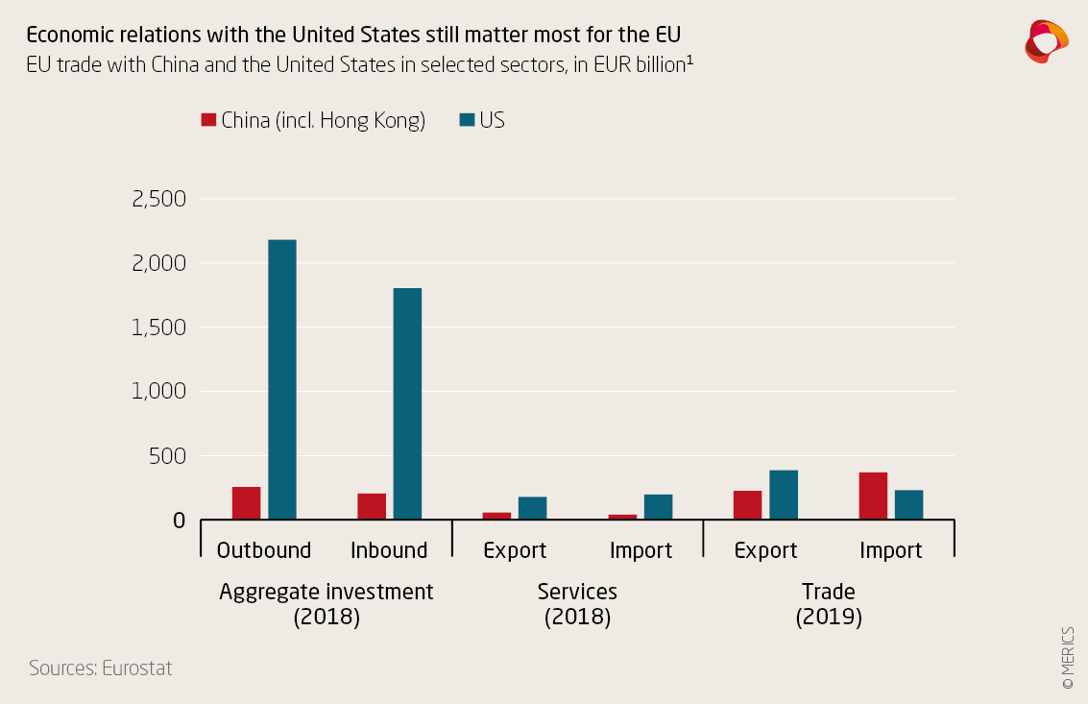
Integrated Deterrence: Regaining allies in Europe?
EU trade dependency with China?
The reality is: EU is more dependent on the US than China

Slide 11
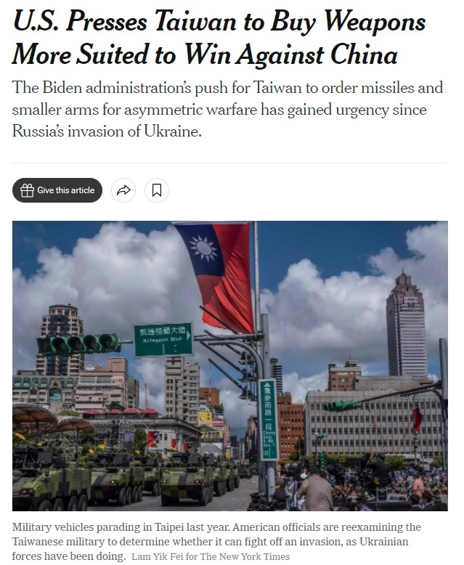
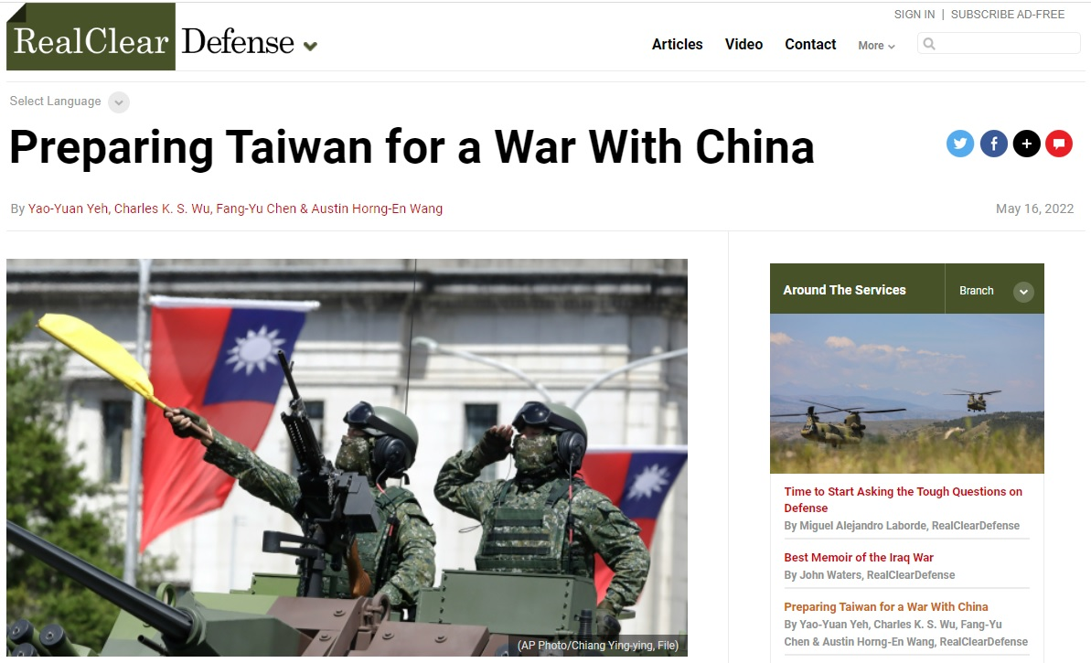
The Merit of Asymmetric Warfare
US arms sales to Taiwan on asymmetric military equipment only?
Again, Ukraine =/= Taiwan
Taiwan shall:
Preparation and acquisition of asymmetric and conventional military weapons are both necessary
Investment in Taiwan’s defense industry
But, there are practical difficulties…

Slide 12
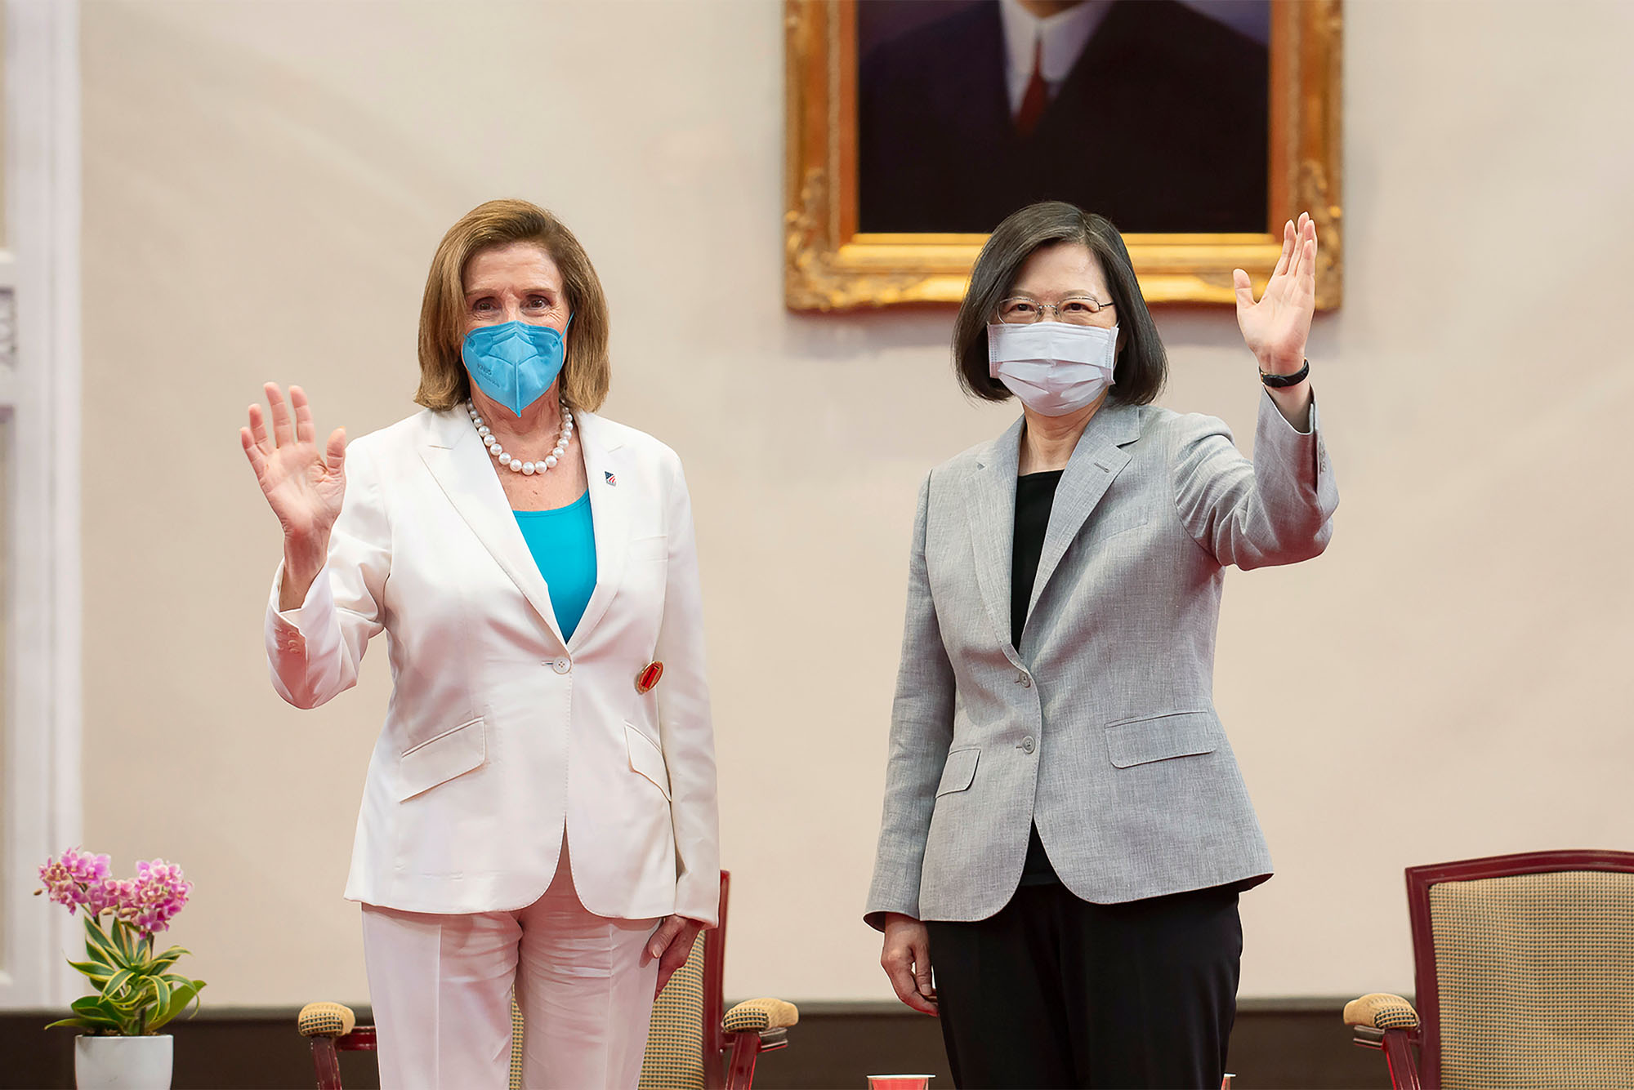
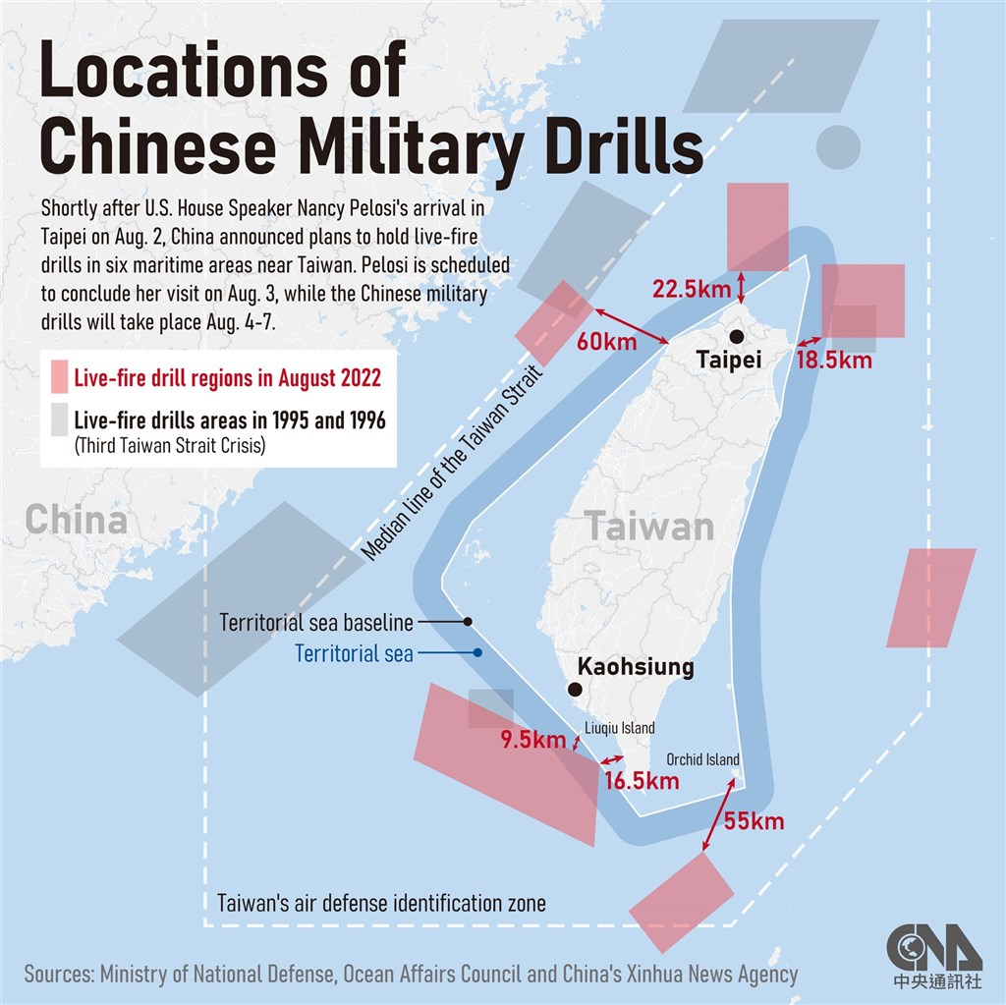
Strategic Clarity vs. Strategic Ambiguity
On August 2, 2022, the Speaker of the House, Nancy Pelosi visited Taiwan and met the President Tsai Ing-wen
Followed by an extensive PLA military drills in Taiwan’s surrounding waters and missiles across Taiwan island
Similar incident occurred when Tsai met with Kevin McCarthy on April 4, 2023

Slide 13
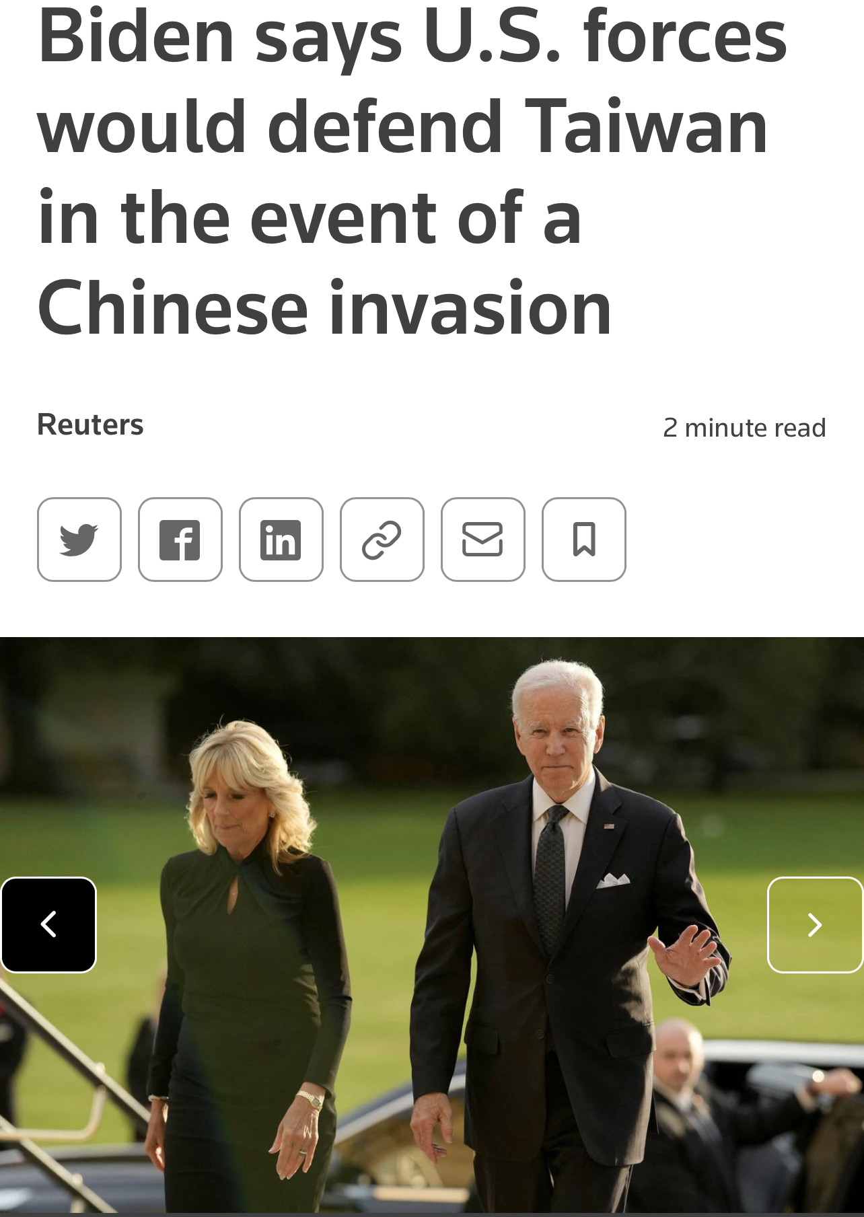
Strategic Clarity vs. Strategic Ambiguity
On September 18, 2022, in CBS 60 Minutes, Biden said:
US military personnel would defend Taiwan if the Chinese military were to launch an invasion of the democratically ruled island
Biden was asked whether "US forces, US men and women, would defend Taiwan in the event of a Chinese invasion
Biden: “Yes”
This is the “fourth time” Biden expressed strategic clarity
This is THE current US Taiwan policy now (non-binding)

Slide 14
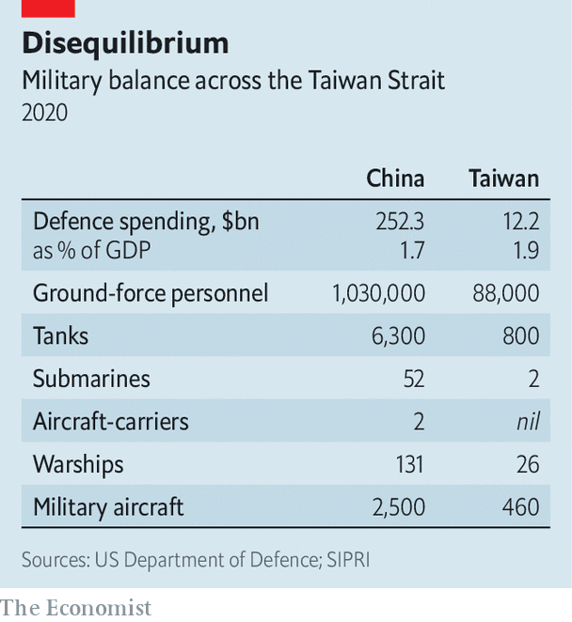
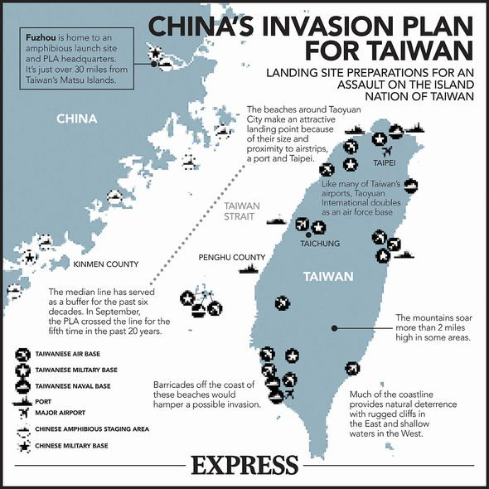
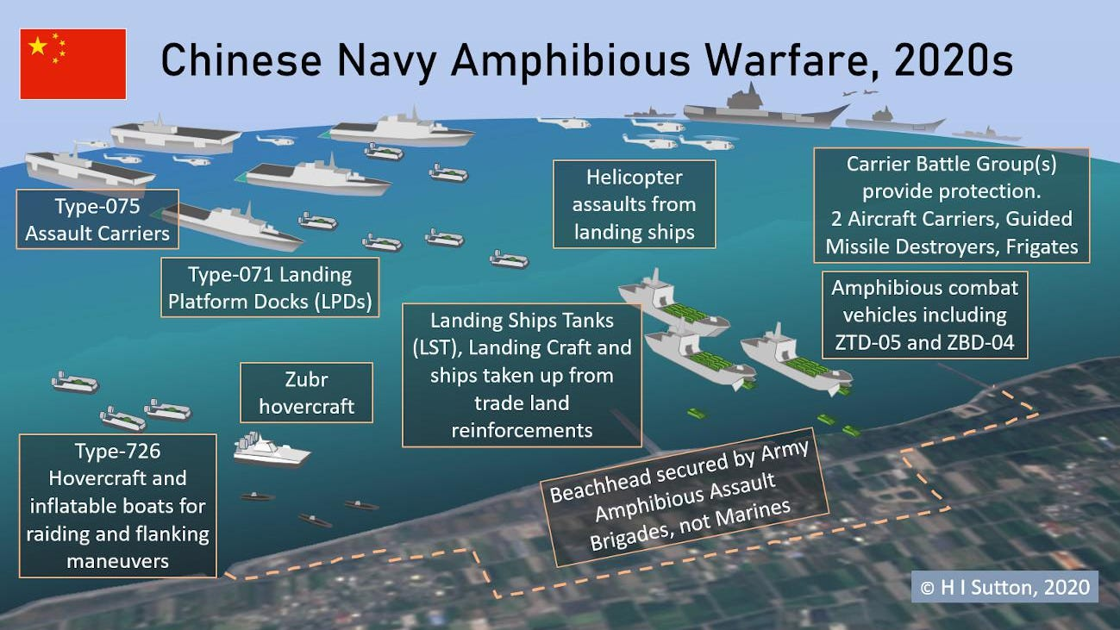
So, Is Taiwan Safer?
Not necessarily
We shall not outsource our security to the US, even if the US adopts the strategic clarity policy now

Slide 15
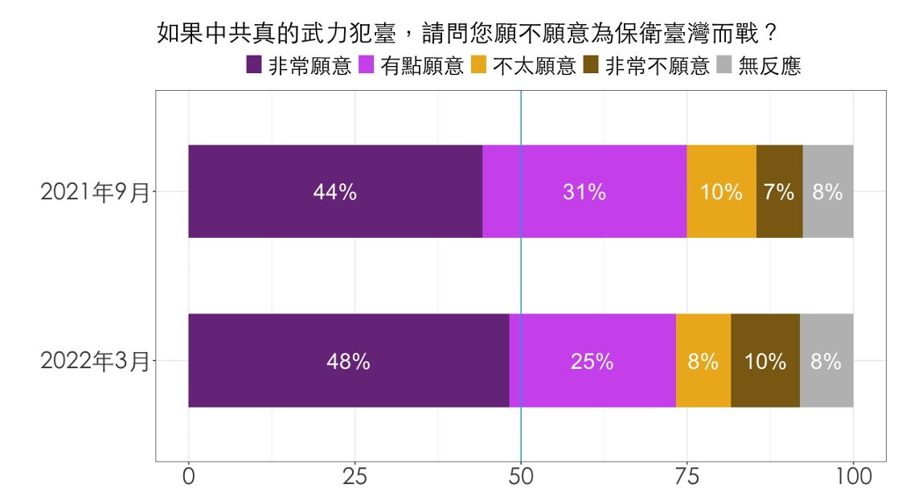
Then What Shall We Do?

Slide 16
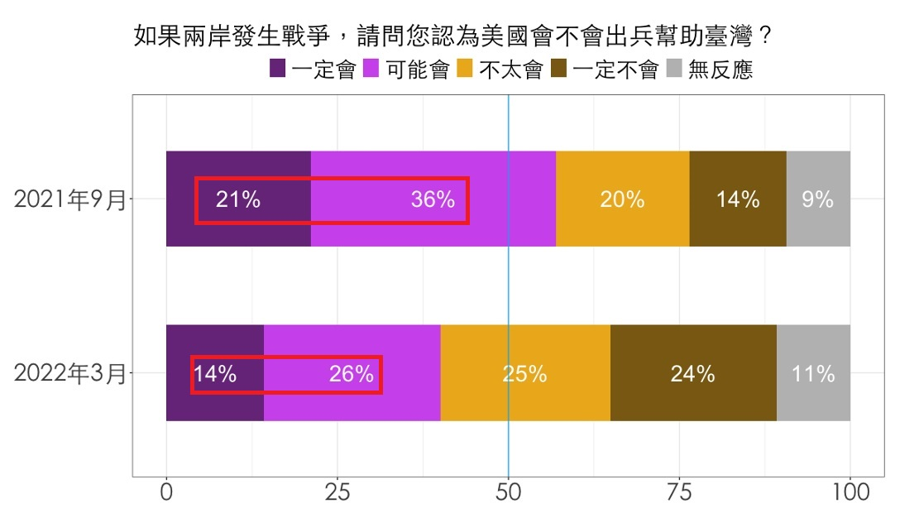
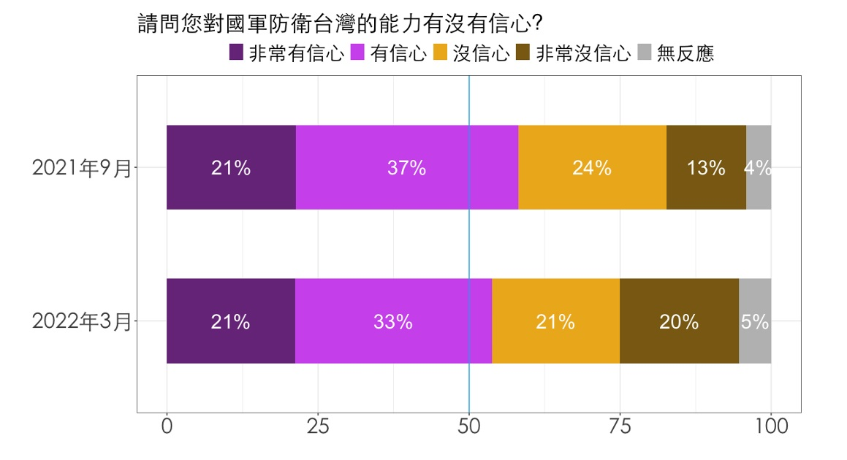
Then What Shall We Do?

Slide 17
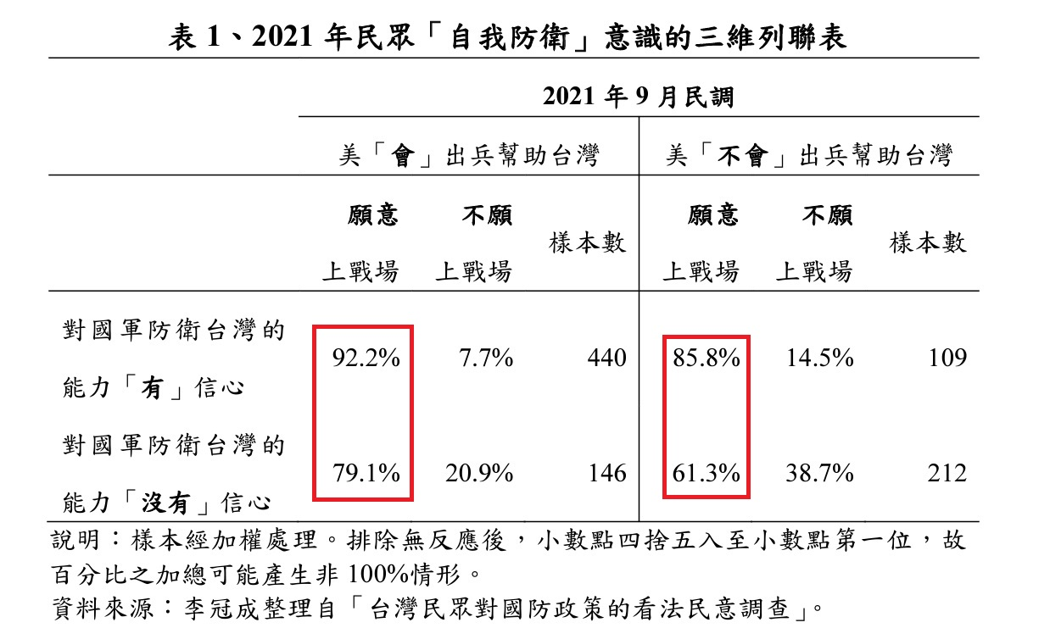
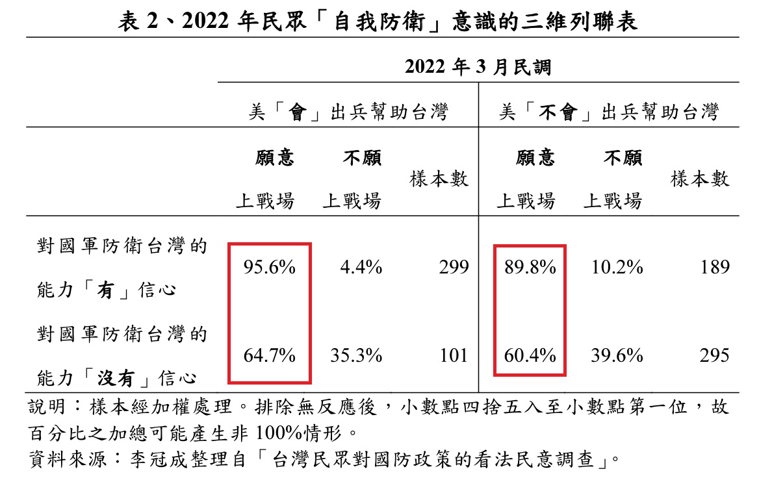
Then What Shall We Do?

Slide 18
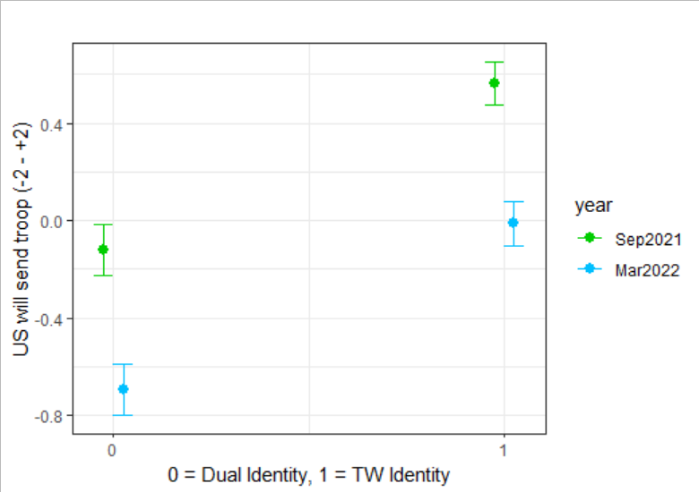
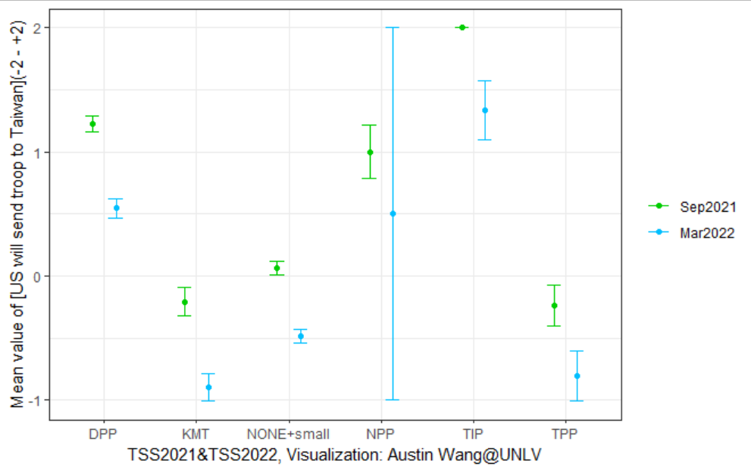
Then What Shall We Do?

Slide 19
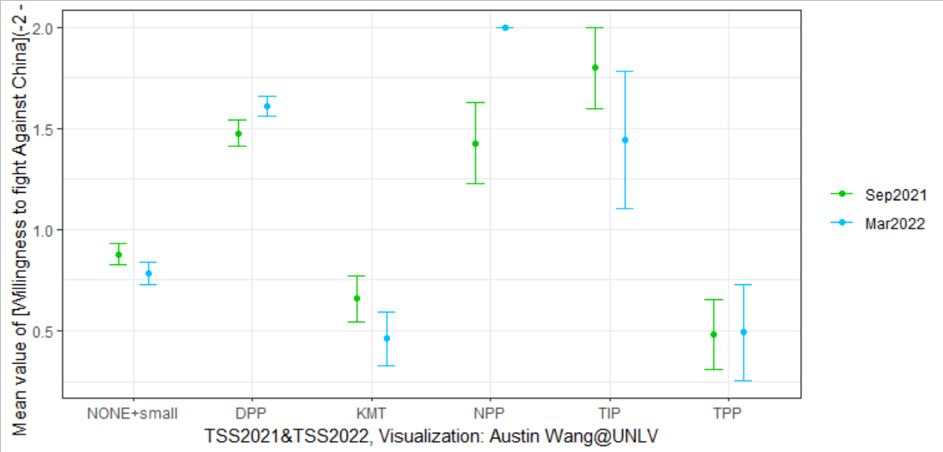
Then What Shall We Do?

Slide 20
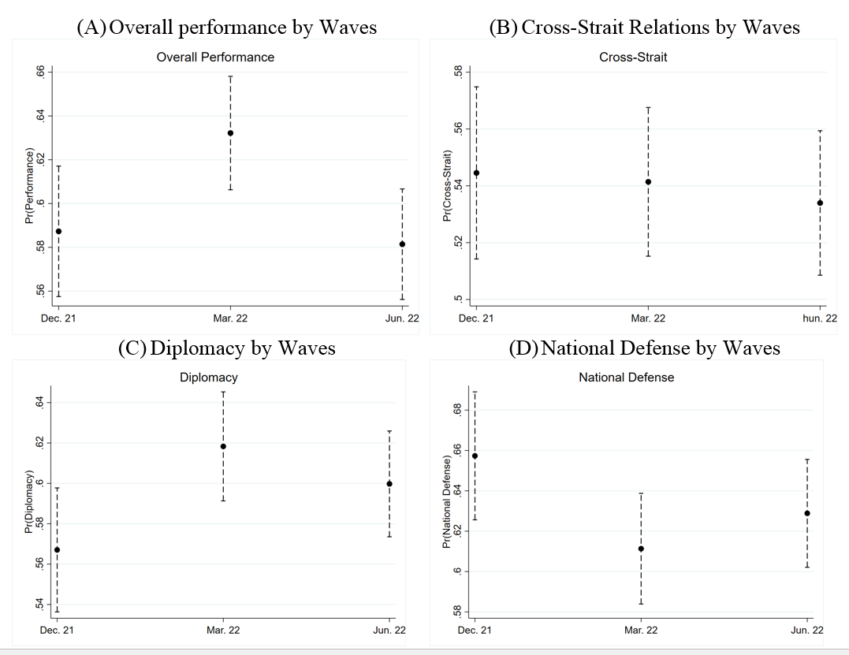
Then What Shall We Do?

Slide 21
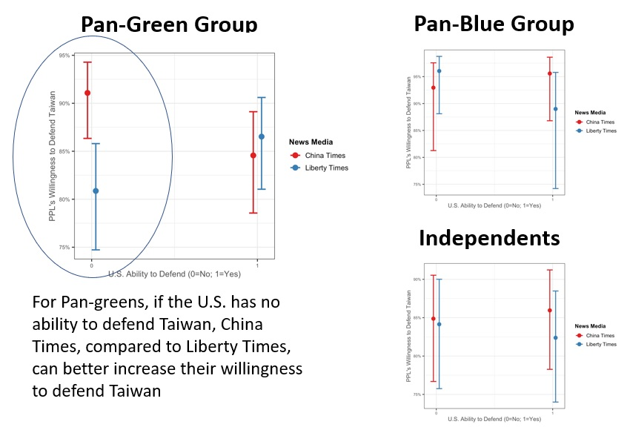
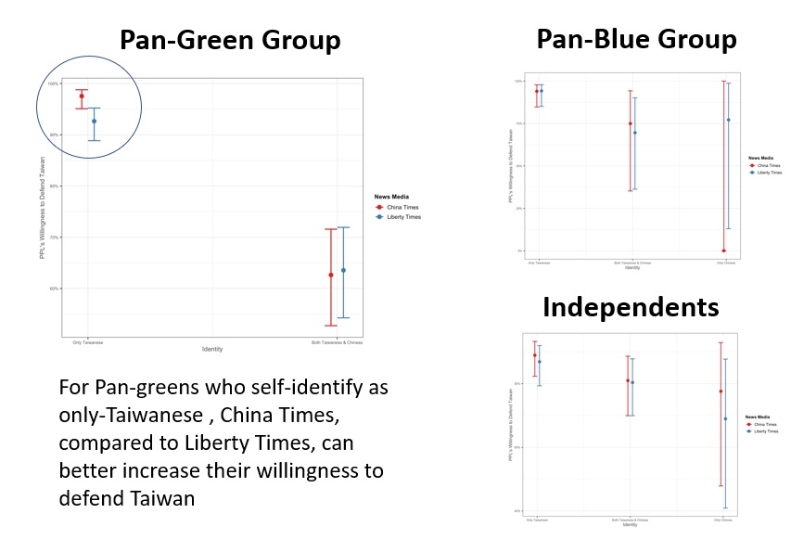
Then What Shall We Do?

Slide 22
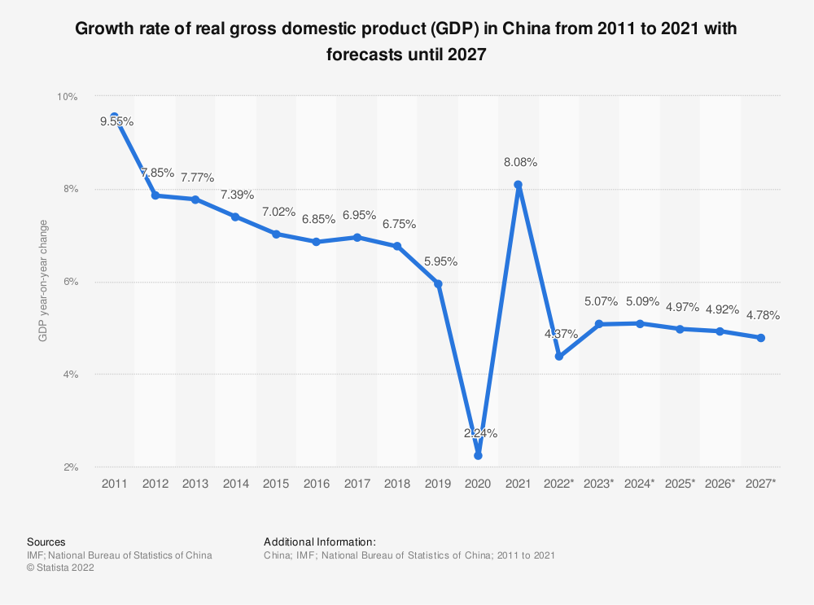
What Would China/Xi Jinping Do?
“All politics are local”
Continuing its Wolf Warrior Diplomacy (for internal and external consistency)
Extending or limiting the winning coalition of Xi’s regime within CCP?
US intelligence estimates 2027 is relatively more dangerous
But it depends on the US/Taiwan’s defense preparation and readiness

Slide 23
Take Away Points
China is still the #1 hegemonic competitor with the US
The US is excercising an integrated deterrence policy against China
The US expresses the strategic clarity policy toward Taiwan
Taiwan needs to enhance its deterrence against PLA by all means
China will continue to be belligerent, but “all politics are local”

Slide 24


Thank you for your attention!
Questions and comments are welcome
Scan the QR Code and find me on Facebook!

